Slide 1
Chapter 14
TEXT MINING
Cios / Pedrycz / Swiniarski / Kurgan

Slide 2
Outline
Introduction
Information Retrieval
  Definition
  Architecture of IR Systems
  Linguistic Preprocessing
  Measures of Text Retrieval
  Vector-Space Model
  Text Similarity Measures
Improving Information Retrieval Systems
  Latent Semantic Indexing
  Relevance Feedback

Slide 3
Introduction
So far we have focused on data mining methods for analysis and extraction of useful knowledge from structured data such as flat files, relational, transactional etc. data.
In contrast, we are text mining is concerned with analysis of text databases that consist of mainly semi-structured or unstructured data such as:
  collections of articles, research papers, e-mails, blogs, discussion forums, and WWW pages

Slide 4
Introduction
Semi-structured data is neither completely structured (e.g., relational table) nor completely unstructured (e.g., free text)
  semi-structured document has:
    some structured fields such as title, list of authors, keywords, publication date, category, etc.
    and some unstructured fields such as abstract and contents

Slide 5
Introduction
There are three main types of retrieval within the knowledge discovery process framework:
  data retrieval - retrieval of structured data from DBMS and data warehouses (Chapter 6)
  information retrieval - concerns organization and retrieval of information from large collections of semi-structured or unstructured text-based databases and the web
  knowledge retrieval - generation of knowledge from (usually) structured data (Chapters 9-13)

Slide 6
Information Retrieval
...[the] actions, methods and procedures for recovering stored data to provide information on a given subject
  ISO 2382/1 (1984)

Slide 7
Information Retrieval
Definitions
  database
    a collection of documents
  document
    a sequence of terms in a natural language that expresses ideas about some topic
  term
    a semantic unit, a word, phrase, or root of a word
  query
    a request for documents that cover a particular topic of interest to the user of an IR system

Slide 8
Information Retrieval
Definitions
  IR system
    its goal is to find relevant documents in response to the user’s request
    performs matching between the language of the query and the language of the document
      simple word matching does not work since the same word has many different semantic meanings
        e.g. MAKE
        “to make a mistake”
        “make of a car”
        “to make up excuses”
        “to make for an exit”
        “it is just a make-believe”

Slide 9
Information Retrieval
Definitions
    other problems
      consider query “Abraham Lincoln”
      should it return document that contains the following sentences: “Abraham owns a Lincoln. It is a great car.”?
      consider query “what is the funniest movie ever made”: how can the IR system know what the user’s idea of a funny movies is?
    difficulties include inherent properties of natural language, high expectations of the user, etc.
      a number of mechanisms were developed to cope with them

Slide 10
Information Retrieval
Cannot provide one “best” answer to the user
  many algorithms provide one “correct” answer, such as SELECT Price FROM Sales WHERE Item = “book”
    or: find shortest path from node A to node B
  IR on the other hand provides a range of possibly best answers and lets the user to choose
    query “Lincoln” may return information about
      Abraham Lincoln
      Lincoln dealership
      The Lincoln Memorial
      The University of Nebraska-Lincoln
      The Lincoln University in New Zealand

Slide 11
Information Retrieval
IR system provides information based on the stored data
  the key is to provide some measurement of relevance between the stored data and the user’s query
    i.e., the relation between requested information and retrieved information
    given a query, the IR system has to check whether the stored information is relevant to the query

Slide 12
Information Retrieval
IR system provides information based on the stored data
  IR systems use heuristics to find relevant information
    they find a “close” answer and use heuristic to measure its closeness to the “right” answer
    the inherent difficulty is that very often we do not know what the right answer is!
      we just measure how close to the right answer we can come
  the solution involves using measures of precision and recall
    they are used to measure the “accuracy” of IR systems

Slide 13

Architecture of IR Systems
database
tagged
data
inverted
index
D1: <DOC> <DOCNO> 1</DOCNO><TEXT>Lincoln Park Zoo is every …</DOC>
D2: <DOC> <DOCNO> 2</DOCNO><TEXT>This website includes a biography, photographs, …</DOC>
….
transformed
query
lincoln: D1, D2, D13, D54, …
zoo: D2, D43, D198, …
website: D1, D2, D3, D4, …
university: D4, D8, D14, …
…
where
university
nebraska
lincoln
textual
data
similarity
measure
similarity (D1, query) = 0.15
similarity (D2, query) = 0.10
similarity (D3, query) = 0.14
similarity (D4, query) = 0.75
…
query
where is the University of Nebraska Lincoln?
D1: Lincoln Park Zoo is everyone’s zoo …
D2: This website includes a biography, photographs, and lots …
D3: Biography of Abraham Lincoln, the sixteenth President
…
document D4
document D52
document D12
document D134
…
Welcome to Lincoln Center for Perfor …
list of
ranked
documents
user
Welcome to the Univers. of Nebraska
March 31, 1849
Lincoln returns …
source
documents

Slide 14
Architecture of IR Systems
  Search database
    is organized as an inverted index file of the significant character strings that occur in the stored tagged data
      the inverted file specifies where the strings occur in the text
      the strings include words after excluding determiners, conjunctions, and prepositions - known as STOP-WORDS
        determiner is a non-lexical element preceding a noun in a noun phrase, e.g., the, that, two, a, many, all
        conjunction is used to combine multiple sentences, e.g., and, or
        preposition links nouns, pronouns, and phrases to other words in a sentence, e.g., on, beneath, over, of, during, beside
      the stored words use a common form
        they are stemmed to obtain the ROOT FORM by removing common prefixes and suffixes
        synonyms to a given word are also found and used

Slide 15
Architecture of IR Systems
  Query
    is composed of character strings combined by Boolean operators and additional features such as contextual or positional operators
      query is also preprocessed in terms of removing determiners, conjunctions, and prepositions
  No linguistic analysis of the semantics of the stored texts, or of the queries, is performed
    thus the IR systems are domain-independent

Slide 16
Linguistic Preprocessing
Creation of the inverted index requires linguistic preprocessing, which aims at extracting important terms from a document represented as the bag of words.
Term extraction involves two main operations:
  Removal of stop words
  Stemming

Slide 17
Linguistic Preprocessing
Removal of stop words
  stop words are defined as terms that are irrelevant although they occur frequently in the documents:
    determiner is a non-lexical element preceding a noun in a noun phrase, and includes articles (a, an, the), demonstratives, when used with noun phrases (this, that, these, those), possessive determiners (her, his, its, my, our, their, your) and quantifiers (all, few, many, several, some, every)
    conjunction is a part of speech that is used to combine two words, phrases, or clauses together, and includes coordinating conjunctions (for, and, nor, but, or, yet, so), correlative conjunctions (both … and, either … or, not (only) … but (… also)), and subordinating conjunctions (after, although, if, unless, because)

Slide 18
Linguistic Preprocessing
Removal of stop words
  stop words are defined as terms that are although they may occur frequently in the documents:
    preposition links nouns, pronouns and phrases to other words in a sentence (on, beneath, over, of, during, beside, etc.)
    Finally, the stop words include some custom-defined words, which are related to the subject of the database
    e.g., for a database that lists all research papers related to brain modeling, the words brain and model should be removed

Slide 19
Linguistic Preprocessing
Stemming
  words that appear in documents often have many morphological variants
  each word that is not a stop word is reduced into its corresponding stem word (term)
    words are stemmed to obtain root form by removing common prefixes and suffixes
    in this way, we can identify groups of corresponding words where the words in the group are syntactical variants of each other, and collect only one word per group
      for instance, words disease, diseases, and diseased share a common stem term disease, and can be treated as different occurrences of this word

Slide 20
Measures of Text Retrieval
Let us suppose that an IR system returned a set of documents to the user’s query.
We define measures that allow to evaluate how accurate (correct) the system’s answer was.
Two types of documents can be found in a database:
  relevant documents, which are relevant to the user’s query
  retrieved documents, which are returned to the user by the system

Slide 21
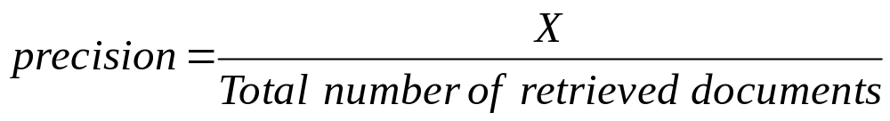
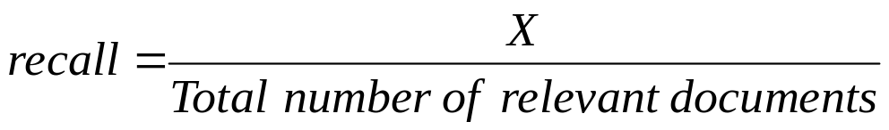
Precision and Recall
 | retrieved | not retrieved
irrelevant | retrieved and irrelevant | not retrieved and irrelevant
relevant | X = retrieved and relevant | not retrieved and relevant
Entire collection of documents
Retrieved documents
Relevant documents
x
Precision
  evaluates ability to retrieve documents that are mostly relevant
Recall
  evaluates ability of the search to find all of the relevant items in the corpus.

Slide 22
Precision and Recall
Trade-off between precision and recall
returns relevant documents but
misses many of them
the ideal case
1
precision
returns most relevant
documents but includes
lots of unwanted documents
0
recall
1

Slide 23
Computing Recall
Number of relevant documents is often not available, and thus we use techniques to estimate it, such as
  sampling across the database and performing relevance judgment on the documents
  applying different retrieval algorithms to the same database for the same query
    the relevant documents are the aggregate of all found documents
  the generated list is a golden standard to compute recall

Slide 24
Computing Recall and Precision
total # of relevant docs = 7
rank | doc # | relevant? | precision/recall
1 | 134 | yes | P = 1/1 = 1, R = 1/7 = 0.14
2 | 1987 | yes | P = 2/2 = 1, R = 2/7 = 0.29
3 | 21
4 | 8712 | yes | P = 3/4 = 0.75, R = 3/7 = 0.43
5 | 112
6 | 567 | yes | P = 4/6 = 0.67, R = 4/7 = 0.57
7 | 810
8 | 12 | yes | P = 5/8 = 0.63, R = 5/7 = 0.71
9 | 346
10 | 478
11 | 7834 | yes | P = 6/11 = 0.55, R = 6/7 = 0.86
12 | 3412
Precision
Recall
still missing one relevant document, and thus will never reach 100% recall
For a given query
  generate the ranked list of retrieved documents
  adjust a threshold on the ranked list to generate different sets of retrieved documents, thus with different recall/precision measures
    mark each document in the ranked list that is relevant according to the gold standard
    compute recall and precision for each position in the ranked list that contains a relevant document

Slide 25
How to Measure Text Similarity?
It is a well-studied problem
  metrics use a “bag of words” model
    it completely ignores word order and syntactic structure
    it treats both document and query as a bag of independent words
      common “stop words” are removed
      words are stemmed to reduce them to their root form
    the preprocessed words are called terms
  vector-space model is used to calculate similarity measure between documents and a query, and between two documents

Slide 26
The Vector-Space Model
Assumptions:
  Vocabulary: a set of all distinct terms that remain after preprocessing documents in the database; it contains t index terms
    these “orthogonal” terms form a vector space
  each term, i, in either a document or query, j, is given a real-valued weight w_{ij.}
    documents and queries are expressed as t-dimensional vectors
    d_{j} = (w_{1j}, w_{2j}, …, w_{tj})

Slide 27
3D Example of the Vector-Space Model
Example
  document D₁ = 2T₁ + 6T₂ + 5T₃
  document D₂ = 5T₁ + 5T₂ + 2T₃
  query Q₁ = 0T₁ + 0T₂ + 2T₃
  which document is
  closer to query?
    how to measure it?
      Distance?
      Angle?
      Projection?
T₃
5
D₁ = 2T₁+ 6T₂ + 5T₃
2
Q = 0T₁ + 0T₂ + 2T₃
D₂ = 5T₁ + 5T₂ + 2T₃
2
5
T₁
5
6
T₂

Slide 28
The Vector-Space Model
T₁ T₂ … T_{t}
D₁ w₁₁ w₂₁ … w_{t1}
D₂ w₁₂ w₂₂ … w_{t2}
: : : :
: : : :
D_{n} w_{1n} w_{2n} … w_{tn}
Collection of n documents
  represented in the vector-space model by a term-document matrix
  a cell in the matrix corresponds to the weight of a term in the document
    value of zero means that the term does not exist in the document
Next we explain how the weights are computed

Slide 29
Term Weights
Frequency of a term
  more frequent terms in a document are more important
    they are more indicative of the topic of a document
    f_{ij} = frequency of term i in document j
  the frequency is normalized by dividing by the frequency of the most common term in the document
    tf_{ij} = f_{ij} / max_{i}(f_{ij})

Slide 30
Term Weights
Inverse document frequency
  used to indicate the term’s discriminative power
    terms that appear in many different documents are less indicative for a specific topic
    df_{i} = document frequency of term i = # of documents containing term I
    idf_{i} = inverse document frequency of term i = log₂ (N / df_{i})
where N is the total # of documents in the database, and log₂ is used to dampen the effect relative to tf_{ij}

Slide 31
TF-IDF Weighting
Term frequency-inversed document frequency (tf-idf)
weighting
w_{ij} = tf_{ij} × idf_{i} = tf_{ij} × log₂ (N / df_{i})
  the highest weight is assigned to terms that occur frequently in the document but rarely in the rest of the database
    some other ways of determining term weights have also been proposed
      the tf-idf weighting was found to work very well through extensive experimentations, and thus it is widely used

Slide 32
Example of TF-IDF Weighting
Consider the following document:
“data cube contains x data dimension, y data dimension, and z data dimension”
where grey color stands for “ignored” letters, and other colors indicate distinct terms
  the frequencies are:
data (4), dimension (3), cube (1), contain (1)
  we assume that the entire collection contains 10,000 documents and the document frequencies of these four terms are
data (1300), dimension (250), cube (50), contain (3100)
  then:
  data: tf = 4/4 idf = log₂(10000/1300) = 2.94 tf-idf = 2.94
  dimension: tf = 3/4 idf = log₂(10000/250) = 5.32 tf-idf = 3.99
  cube: tf = 1/4 idf = log₂(10000/50) = 7.64 tf-idf = 1.91
  contain: tf = 1/4 idf = log₂(10000/3100) = 1.69 tf-idf = 0.42

Slide 33
Text Similarity Measure
Text similarity measure is a function used to compute degree of similarity between two vectors
  usually is used to measure similarity between the query and each of the documents from the database
    it is used to rank the documents
      the order indicates their relevance to the query
    usually a threshold is used to control the number of retrieved relevant documents

Slide 34
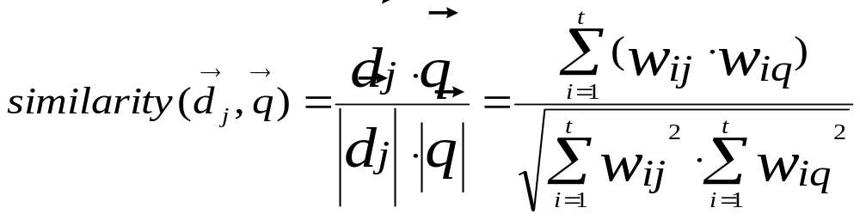
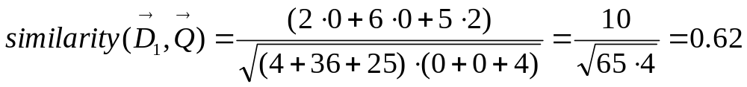
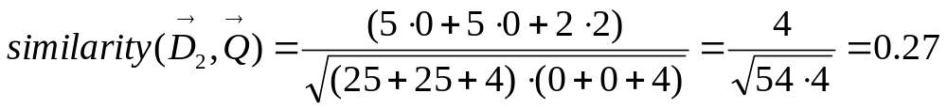
Cosine Similarity Measure
T₃
5
D₁ = 2T₁+ 6T₂ + 5T₃
2
Q = 0T₁ + 0T₂ + 2T₃
D₂ = 5T₁ + 5T₂ + 2T₃
2
5
T₁
5
Is defined as the cosine of the
angle between two vectors
        where t is # of terms
  example
    D₁ = 2T₁ + 6T₂ + 5T₃, D₂ = 5T₁ + 5T₂ + 2T₃, Q₁ = 0T₁ + 0T₂ + 2T₃
    document D₁ is twice more similar to the query than document D₂
6
T₂

Slide 35
Improving IR Systems
The basic design of the IR systems described so far can be enhanced to increase precision and recall, and to improve the term-document matrix
  The former issue is often addressed by using relevance feedback mechanism,
  while the latter is addressed by using latent semantic indexing

Slide 36
Improving IR Systems
Latent Semantic Indexing
  improves effectiveness of the IR system by retrieving documents that are more relevant to a user's query through manipulation of the term-document matrix
    original term-document matrix is often too large for the available computing resources, is presumed noisy (some anecdotal occurrences of terms should be eliminated) and too sparse with respect to the "true" term-document matrix
  therefore, the original matrix is approximated by a smaller, “de-noisified” matrix
    the new matrix is computed using singular value decomposition (SVD) technique (Chapter 7)

Slide 37
Improving IR Systems
IR system
2
1
4
new terms
3
5
query
3
new query
Relevance Feedback
  modification of the
  information search
  process to improve
  accuracy
  it adds terms to the initial query that may match relevant documents
    perform IR search on the initial query
    get feedback from the user as to what documents are relevant and find new (with respect to the initial query) terms from known relevant documents
    add new terms to the initial query to form a new query
    repeat the search using the new query
    return a set of relevant documents based on the new query
    user evaluates the returned documents
6
Matching documents
user

Slide 38
Improving IR Systems
Relevance Feedback
  performed manually
    user manually identifies relevant documents, and new terms are selected either manually or automatically
  performed automatically
    relevant documents are identified automatically by using the top ranked documents, and new terms are selected automatically
      identification of the N top-ranked documents
      identification of all terms from the N top-ranked documents
      selection of the feedback terms
      merging the feedback terms with the original query
      identifying the top-ranked documents for the modified query

Slide 39
Improving IR Systems
Relevance Feedback
Pros
  it usually improves average precision by increasing the number of good terms in the query
Cons
  requires more computational work
  it can decrease effectiveness
    one bad new word can undo the good caused by lots of good words

Slide 40
References
Baeza-Yates, R. and Ribeiro-Neto, B 1999. Modern Information Retrieval, Addison Wesley
Feldman, R. and Sanger, J. 2006. The Text Mining Handbook: Advanced Approaches in Analyzing Unstructured Data, Cambridge University Press
Hotho, A., Nürnberger, A. and Paaß, G. 2005. A Brief Survey of Text Mining, GLDV-Journal for Computational Linguistics and Language Technology, 20(1):19-62
Salton, G. and McGill, M. 1982. Introduction to Modern Information Retrieval, McGraw-Hill

